Slide 1
Scaling out deployments with Juju
DevOps Distilled

Slide 2
Jorge O. Castro
Developer Relations
Canonical Ltd.
Juan L. Negron
Systems Integration Engineer
Canonical Ltd.

Slide 3


Slide 4
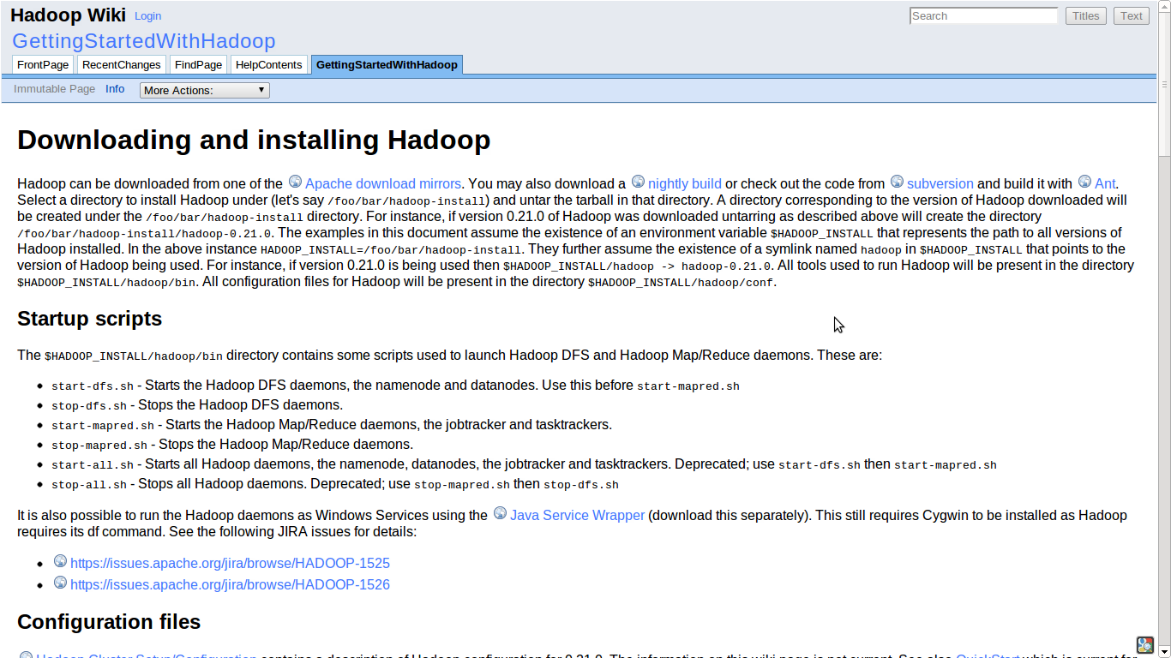

Slide 5
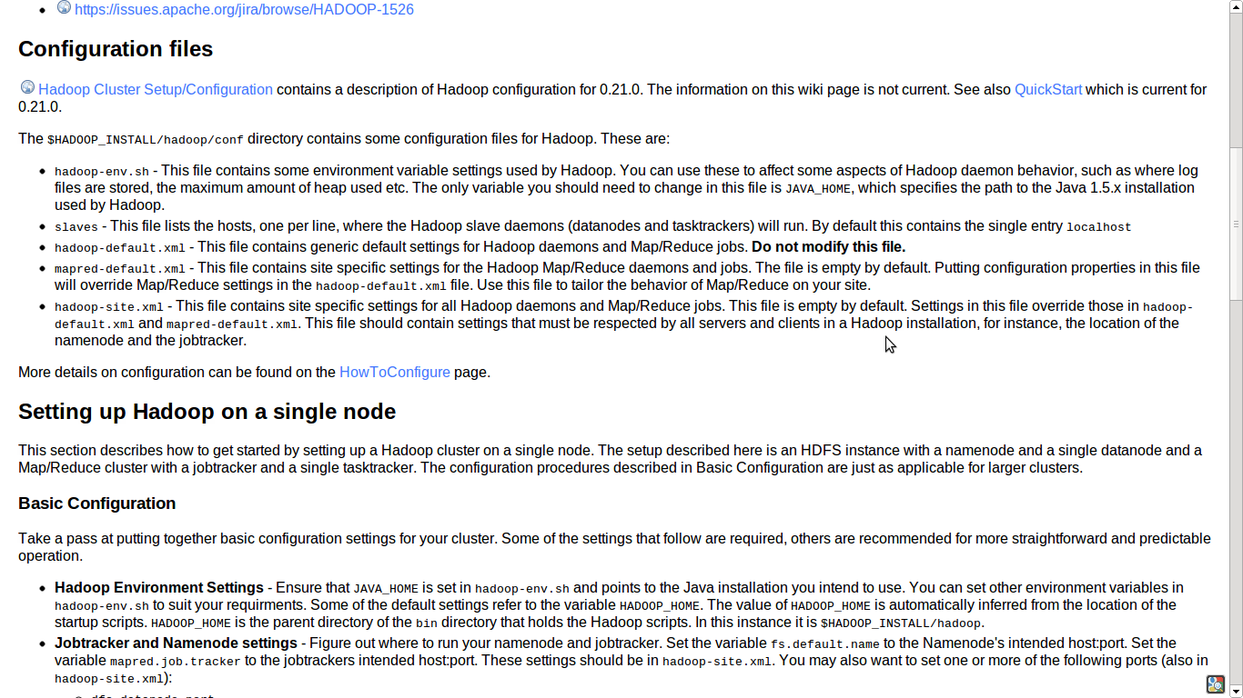

Slide 6
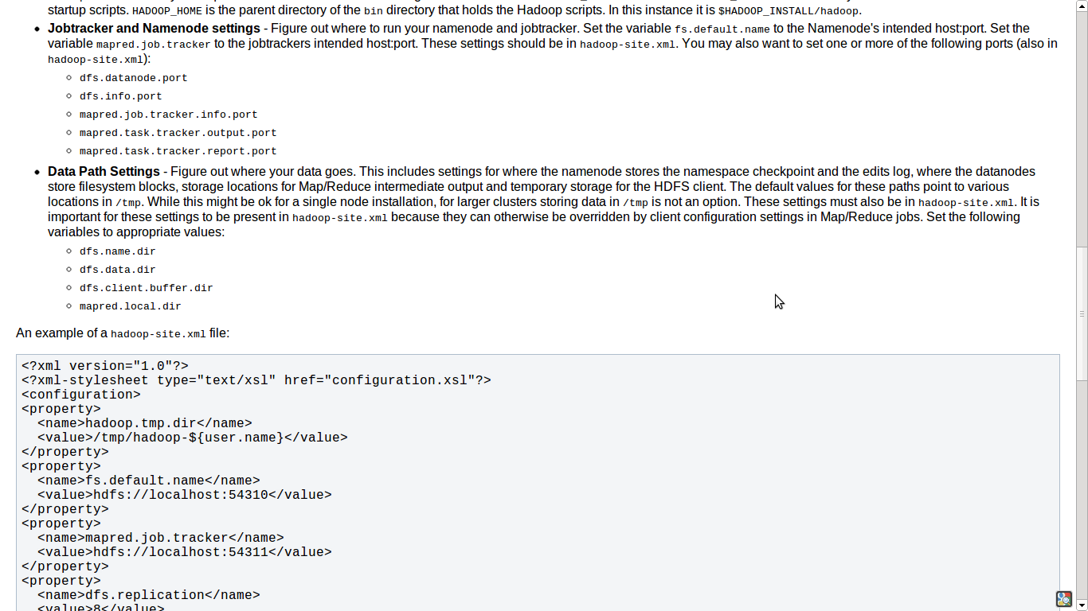

Slide 7
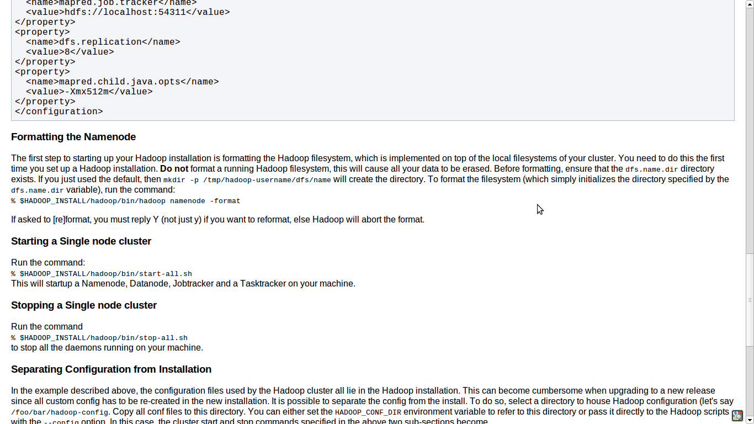

Slide 8
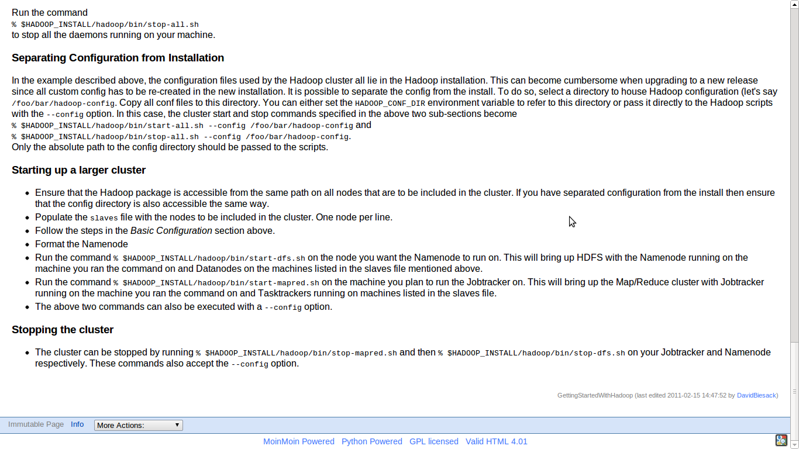

Slide 9
$ juju bootstrap
$ juju deploy hadoop-master
$ juju deploy hadoop-slave
Notes:
How did I do that! (OMG)

Slide 10
Charms
Reusable, codified best-practice.
Distilled deployment expertise.
Communication via interfaces.
Doesn't require foreknowledge of who will use them or how

Slide 11
You've got the tools already
Hardware
Virtualization
Platform (OS)
Configuration Management
… need to tie that together into something whole.

Slide 12
Manages Services, not Machines
Devops Distilled
Notes:
We take your expertise and distill it into Juju Charms
Higher level than configuration management.
Only do things once, don't repeat yourself.
Don't repeat others.
Best practice out of the box.
Think of it like an API layer for your deployment.
No restriction on how you want to deploy

Slide 13
Elevate to Juju
Service
Orchestration
Configuration
Management
Virtualization
Operating
System
Hardware

Slide 14
Juju is
DevOps distilled.
Charms are a shareable, re-usable, and repeatable expressions of DevOps best practices. You can use them unmodified, or easily change and connect them to fit your needs. Deploying a formula is similar to installing a package on Ubuntu: ask for it and it’s there, remove it and it’s completely gone.

Slide 15
Juju is a community of DevOps expertise.
Most of the application you want will be available in Juju. Juju provides direct and free access to a DevOps community-contributed collection of formulas

Slide 16
Juju provides service orchestration.
Juju focuses on managing the service units you need to deliver a single solution, above simply configuring the machines or cloud instances needed to run them. Charms developed, tested, and deployed on your own hardware will operate the same in an EC2 API compatible cloud.

Slide 17
Juju is intelligent.
Juju exposes re-usable service units and well-defined interfaces that allow you to quickly and organically adjust and scale solutions without repeating yourself.

Slide 18
Juju is easy.
There’s no need to learn a domain specific language (DSL) to use Juju or create formulas. You can be up and running with your own formula in minutes.

Slide 19
Orchestrates provisioning (EC2, OpenStack, Bare Metal)
Write your formulas in whatever language you want.

Slide 20
Charms
Reusable, codified best-practice.
Distilled deployment expertise.
Communication via interfaces.
Doesn't require foreknowledge of who will use them or how

Slide 21
Charms
Reusable, codified best-practice.
Distilled deployment expertise.
Communication via interfaces.
Doesn't require foreknowledge of who will use them or how

Slide 22





~40 formulas

Slide 23
Relating services
Notes:
Deployment is easy, a big deal problem, lots of VC there.
BUT You're not done!!!! This is where the meat is.
You don't need to spend all this time investigating how the different parts fit together.
And test it fucking around, just get it done.

Slide 24
Relations
A high-level interface describing the interactions between services
Services have `provides` and `requires` interfaces
Juju models the relationship between services, not machines

Slide 25
Scaling services

Slide 26
Services
Services change during their lifetime:
Number of instances?
Which machines they run on?
What services they depend on?
And how those services are implemented?

Slide 27
$ juju bootstrap
$ juju deploy hadoop-master
$ juju deploy hadoop-slave
$ juju add-relation hadoop-master hadoop-slave
$ juju add-unit hadoop-slave

Slide 28
$ juju bootstrap
$ juju deploy hadoop-master
$ juju deploy hadoop-slave
$ juju add-relation hadoop-master hadoop-slave
$ juju add-unit hadoop-slave
$ juju add-unit hadoop-slave

Slide 29
$ juju bootstrap
$ juju deploy hadoop-master
$ juju deploy hadoop-slave
$ juju add-relation hadoop-master hadoop-slave
$ juju add-unit hadoop-slave
$ juju add-unit hadoop-slave
$ juju add-unit hadoop-slave

Slide 30
Juju Under the Hood

Slide 31
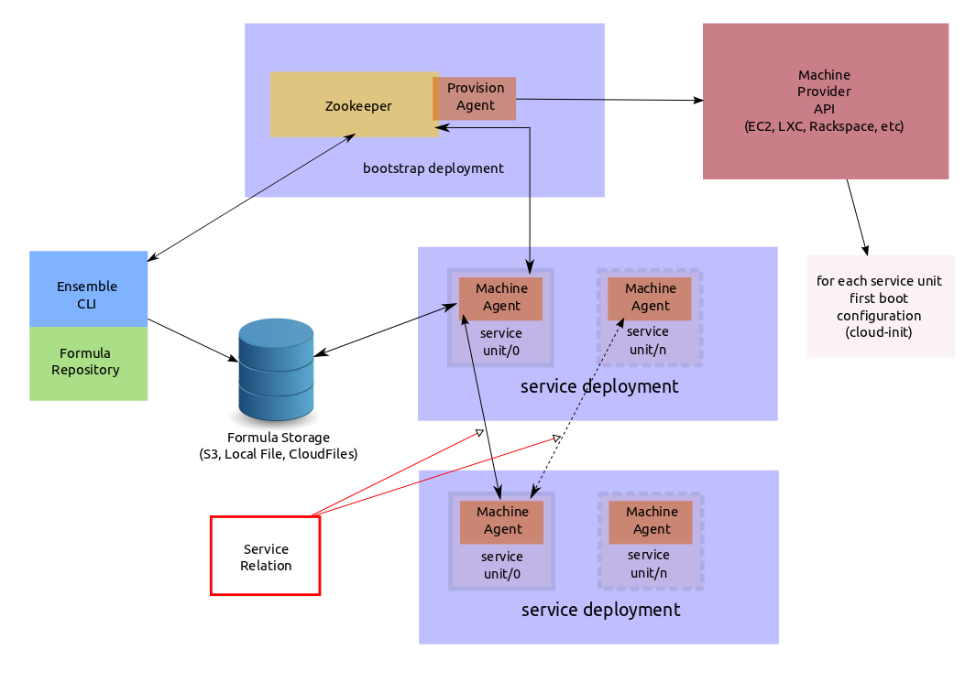

Slide 32

Juju
Juju treats individual services as atoms that are described as formulas and can be instantiated one or many times.
Juju environment
Cloud app
Cloud app
Cloud app
and dependency solver

Slide 33
Juju
Load
Balancer
HAProxy
Each formula (or atom) define dependencies and/or provides.
Depends
Provides
Juju environment
Cloud app
Cloud app
Cloud app
and dependency solver
Provides
Depends
SQL Database
MySQL

Slide 34
Juju
Load
Balancer
HAProxy
Varnish
Multiple formulas can provide the same service and can be easily switched.
Depends
Provides
Juju environment
Cloud app
Cloud app
Cloud app
and dependency solver
Provides
Depends
SQL Database
MySQL

Slide 35
Juju
Varnish
Varnish
Juju maintains the relations between the services so that you don't need to care about the elasticity of your environment.
Relations are to formulas what bounds are to atoms.
Services are loosely coupled but highly cohesive.
Juju Relation
Juju environment
Cloud app
Cloud app
Cloud app
and dependency solver
Juju Relation
MySQL
MySQL
MySQL

Slide 36
Juju
Varnish
Juju delivers service focused management through their life-cycle
Offers the same simple rules to components of you infra as we do already for packages on your servers: dependencies, provides
Adds the notion of dynamic relations between components
To provide you with simple automated elasticity that is easy to expand
Working on your bare metal servers (through Orchestra*) as easily as on your favourite clouds (AWS, OpenStack*, ...)
Juju Relation
Juju environment
Cloud app
Cloud app
Cloud app
and dependency solver*
Juju Relation
MySQL
MySQL
*coming soon

Slide 37
DEMO

Slide 38
All development is public
Communication is open
Join Us
IRC: #juju on irc.freenode.net
Launchpad: https://launchpad.net/juju
Web: https://juju.ubuntu.com/

Slide 39
cloud.ubuntu.com

